Slide 1
Applying for High School 2025

Slide 2
Important Information!
National closing date 31ST OCTOBER 2024. It is vital that all parents submit an online application before the closing date. Late applications will not be processed until after the offer date
Applications received after 31 October 2024 will be treated as late. Late applications will be processed in April 2025.
National Offer date is 3rd March 2025
Admissions help line : 01582 548016

Slide 3
Preparation-what you may need
Look up your catchment area school at www.luton.gov.uk/admissions. If you want a place at your catchment area school, you must still apply and name that school as one of your preferences. It is not automatically allocated.
Prepare the additional documents that you will need to upload such as: Proof of address is needed for some schools: Challney High school for Boys, Challney High school for Girls, Chiltern Academy, Denbigh High School and Putteridge High School.
Catholic school applications will need your child’s original Baptismal Certificate and a supplementary form.
Look at the ‘How to apply for a school place 2025’ guide available at Luton School Admissions home page The guide gives information on individual schools and academies in Luton allowing you to judge your chances of securing a place at your preferred schools. There is also a handy application checklist on the same page.
Have your email address and password ready as you will need these during the registration process

Slide 4
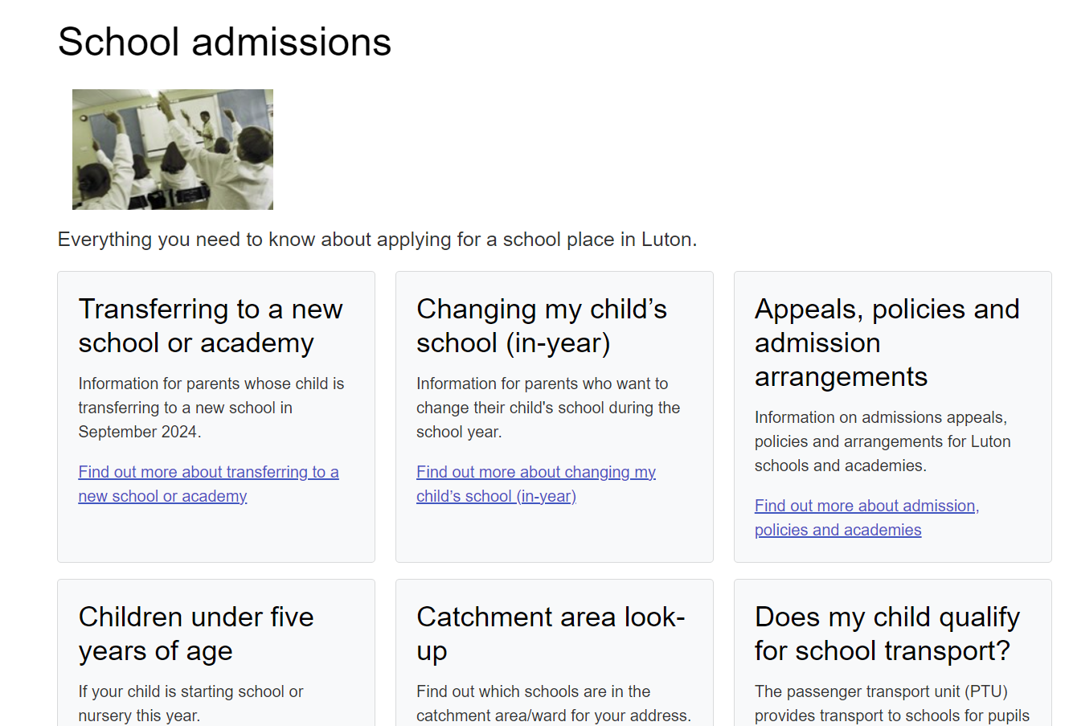
How to apply online
First navigate to School admissions page on the Luton Borough Council Website. Then select “Transferring to a High School in 2025” box

Slide 5
Education Portal

Slide 6
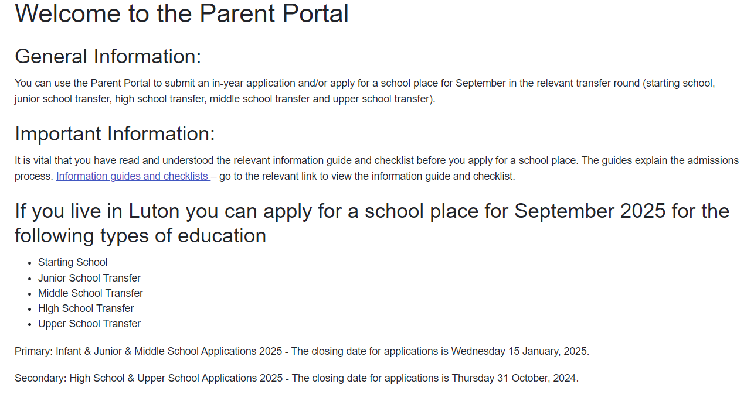

Slide 7
Tips and hints on how to use the portal
➢ You may need to register for a new account, even if you have used the portal before.
➢ You will be sent an email and click on the confirmation link.
➢ You are ready to log in using your email address and password.
➢ Follow the steps.
➢ You can go back into the portal as many times as you like prior to the closing date if you wish to make changes. Preferences can be changed at any time until the closing date.
➢ Remember to put information of siblings who will be attending the preferred school at the time your child transfers.
➢ At the end remember to click submit.
Your submission email is proof of application.

Slide 8
Preferences
You can apply for three schools – these are called preferences and all three will be given equal consideration. Parents/carers must identify their first, second and third preference schools on their application. It is important to name three different schools.
Ensure that you consider realistic ‘back-up’ preferences. Think about scenarios and the logistics should the preferred school(s) not be allocated. Transport costs are usually the responsibility of the parent (some exceptions).
It doesn’t matter how early you apply; you do not jump the queue by applying early.
You can apply to any school or academy. Remember to consider how likely you are going to be and refer to the booklet to gauge what your chances are. Always consider putting the catchment area school as a back up preference.
Applications for Luton schools and out of borough schools should be applied for via Luton Borough Council.
Apply directly via the school if applying for a private school.
Applications from parents living outside of Luton must do so by following their ‘home’ Council’s application process. Their Council will forward the application to Luton Council for consideration. Luton Council will inform the pupil’s ‘home’ Council of the outcome of the application. Where both authorities can offer a school place, the highest-ranking preference that can be offered will be confirmed and any lower ranking offers will be eliminated

Slide 9
Criteria
Criteria are a set of “rules” each school has to allocate places at a school.
Each school is slightly different and it is useful to check where your child sits within these.
Each school publishes theirs in the guide online.

Slide 10
Criteria

Slide 12
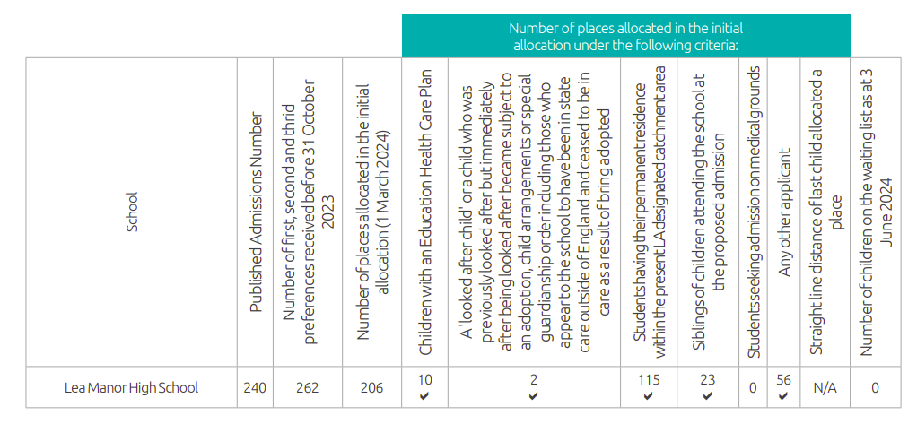

Slide 13
Frequently asked questions
If I apply early, I will get my first-choice school?
No, applications are not processed on a first come first served basis. Places are allocated using the schools admissions criteria which you can find in the How to apply for a school place 2022 guide.
If I apply for the same school three times, will I stand a better chance?
No, you should apply for three different schools.
We might move house, shall I wait until we move?
You must apply at the address you are living at prior to the closing date.
We have other children attending our preferred school, will this guarantee a place for
my child?
Please remember to add the sibling to the application however this does not guarantee you a place automatically.
My child has a cousin at the school, do they count as a sibling?
No, cousins do not count as siblings.

Slide 14
Applying to Catholic Schools
Parents wishing to apply for a place at Cardinal Newman Catholic School must also complete the school’s supplementary form and provide the original Baptismal certificate.
The supplementary form and Baptismal certificate can be returned to the child’s current school or Admissions Team.
Part 2 of supplementary form should be left blank. Do not take the form to your Priest/ Minister – the school will request completion from the Priest/ Minister after the closing date.
Supplementary forms and baptismal certificates MUST be submitted by the closing date.
For out of borough Catholic Schools please refer to the individual schools for their application process.

Slide 15
Appeal process
Parents/ carers can apply for an appeal for any school preference that they have applied for and have been unsuccessful.
An appeal application needs to be submitted within 20 school days from receipt of the offer letter to be considered in the first round of appeals.
There are no guarantees that an appeal will be upheld. It is important that you do not rely on the appeal process to gain a place at your preferred school.
You can only appeal once per academic year unless there are significant and material changes to circumstances.
If it is not possible to allocate your child a place at one of your preferred schools you can ask for your case to be considered by an independent appeal panel.
Please see Admissions page on LBC Website.

Slide 16
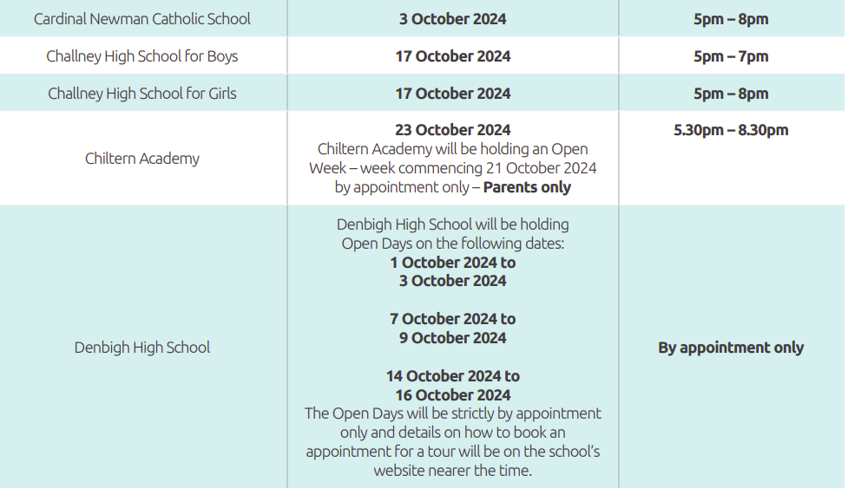

Slide 17
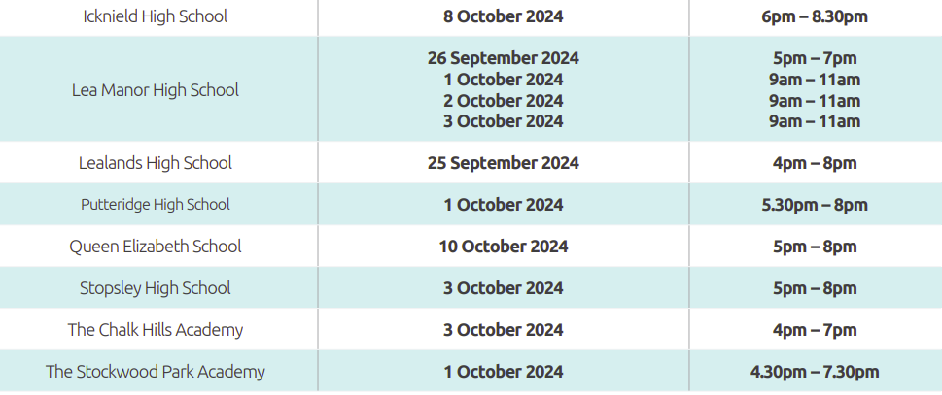

Slide 18
Any questions??? Please do contact Miss Legg or Mrs Altaf if you need any help, support or guidance through the process. clegg@bramingham.net galtaf@bramingham.net

